Slide 1

2025 Deliberative Session
Town of Rindge February 1, 2025

Slide 2
Contents
1. Welcome & Introductions
2. Officials for the year ensuing
3. Proposed Budget
4. Warrant Articles 10-27

Slide 3
Welcome & Introduction
Welcome to the Town of Rindge Deliberative Session. THANK YOU ALL for coming.
Thank you to all our Town employees and the many volunteers that work diligently throughout the year and provide exceptional services to our residents.
Board of Selectmen Town Department Heads
Karl Pruter, Chairman Lori Rautiola, Town Administrator
Robert Hamilton Laurie May, Finance Director
Thomas Coneys Shana Eichner, Town Clerk
Andrea LaVache, Tax Collector
Budget Advisory Committee Al Bump, Planning Director
Phil Motta, Chairman Rachel Malynowski, Police Chief
Dan Whitney Rickard Donovan, Fire Chief
Tina Sbrega Michael Cloutier, Public Works Director
James Burger Dan Bemis, Recreation Director
Casey Burrage Donna Straitiff, Library Director
Roberta Oeser
Robert Hamilton, Ex Officio

Slide 4
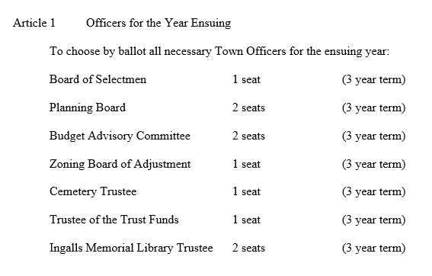

Officials for the Year Ensuing

Slide 5
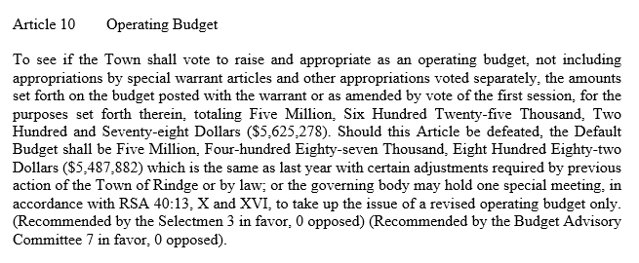
Article 10 Operating Budget
Article 10
$272,544= Total Overall Increase
Tax Impact = $124 on a $350,000 home

Slide 6
Breakdown of Proposed Budget
2024 Budget $5,352,734
Full year for 2 hires (PD) + $81,839
Prosecutor Increase + $18,624
53rd Pay week + $53,970
Ambulance Service + $40,000
$194,433
3.6% Increase going into 2025 $5,547,147
Going into 2025 $5,547,167
BAC Proposed a 5% increase
over last year
Only allowing a 1.47% Increase $78,111
Savings Health Insurance ($73,000)
Operating budget cuts
5% Increase over last year $5,625,278

Slide 7
Default Budget
Getting from the Default to the Proposed Budget
Default Budget = $5,487,882
(Includes mandated or contractual obligations)
2025 Proposed Budget is $137,396 over the Default

Slide 8
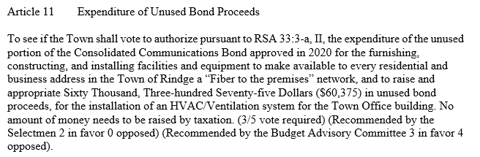
Article 11 Expenditure of Unused Bond Proceeds
There is NO TAX IMPACT.

Slide 9
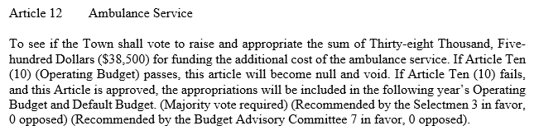
Article 12 Ambulance Service

Slide 10
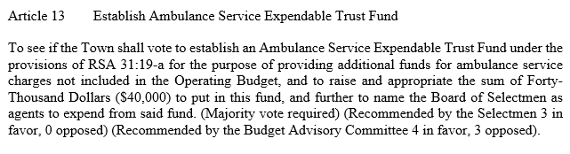
Article 13 Establish Ambulance Service Expendable Trust Fund
Tax impact = $18 on a $350,000 home.

Slide 11
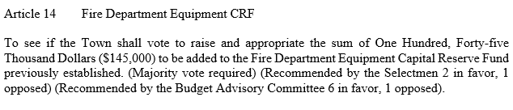
Article 14 Fire Department Equipment CRF
Tax Impact = $66 on a $350,000 home.
*The current balance of this fund is approximately $103,150.

Slide 12
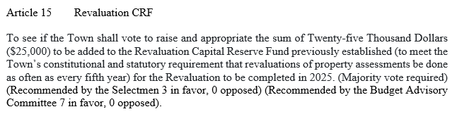
Article 15 Revaluation CRF
NO ADDITIONAL tax impact.
The current balance of this fund is approximately $112,877.

Slide 13
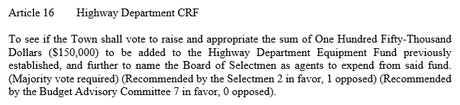
Article 16 Highway Department CRF
Tax impact = $46 on a $350,000 home.
*The current balance of this fund is approximately $100,309.

Slide 14
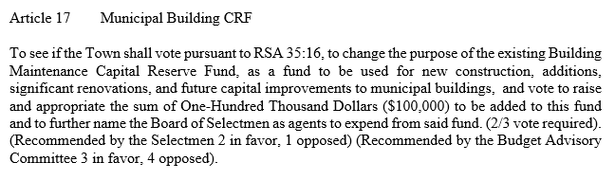
Article 17 Municipal Building CRF
Tax impact = $46 on a $350,000 home.
*The current balance on the “Building Maintenance Fund” is $99,500.

Slide 15
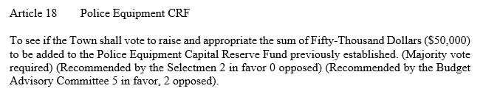
Article 18 Police Equipment CRF
Tax impact = $18 on a $350,000 home.
*The current balance of this fund is approximately $10,475.

Slide 16
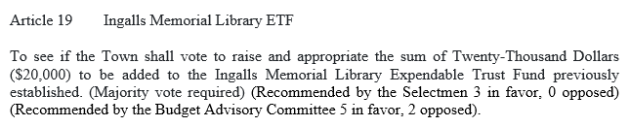
Article 19 Ingalls Memorial Library
Tax impact = $2 on a $350,000 home.
*The current balance of this fund is approximately $85,278.

Slide 17
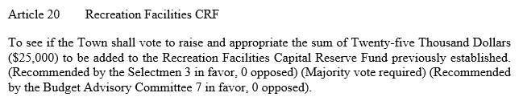
Article 20 Recreation Facilities CRF
NO ADDITIONAL tax impact.
*The current balance of this fund is approximately $50,255.

Slide 18
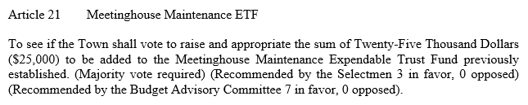
Article 21 Meetinghouse Maintenance ETF
Tax impact = $11 on a $350,000 home.

Slide 19
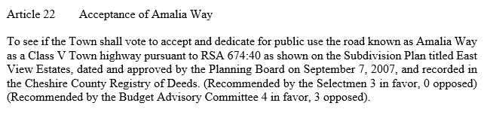
Article 22 Acceptance of Amalia Way

Slide 20
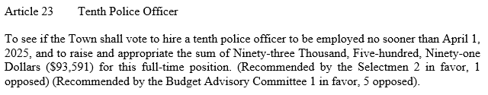
Article 23 Tenth Police Officer
Tax impact = $43 on a $350,000 home.

Slide 21
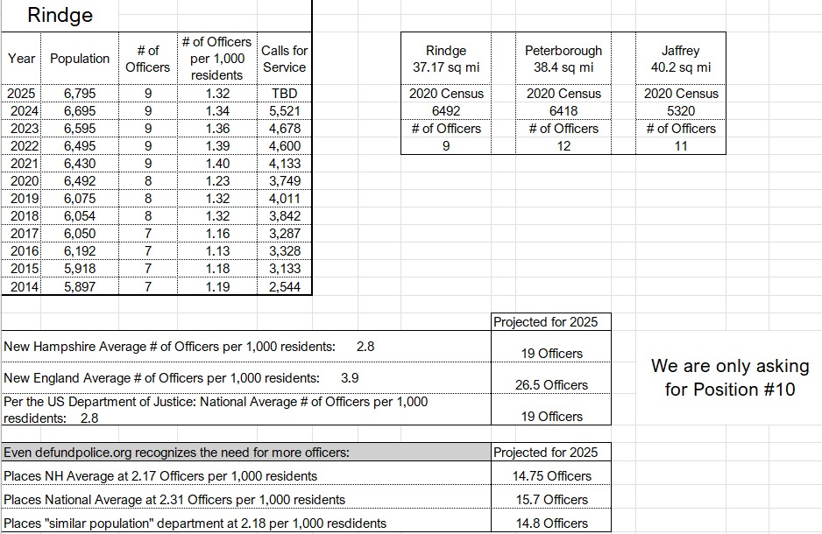
Article 23 Tenth Police Officer

Slide 22
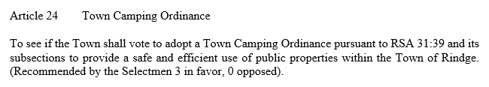
Article 24 Town Camping Ordinance

Slide 23
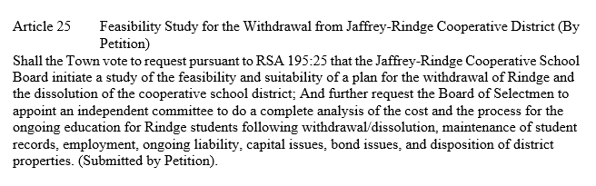
Article 25 Feasibility Study for the Withdrawal from Jaffrey Rindge Cooperative School District (By Petition)

Slide 24
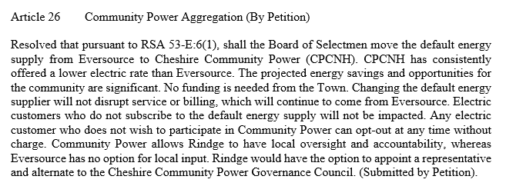
Article 26 Community Power Aggregation (By Petition)

Slide 25
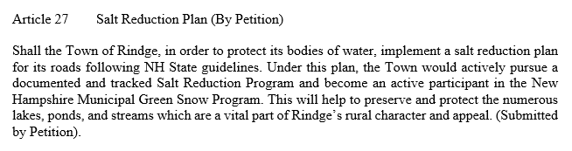
Article 27 Salt Reduction Plan (By Petition)

Slide 26
Thank you
Thank you for coming out today and for your patronage to the Town of Rindge.
We look forward to serving you in 2025!

